Slide 1
List?

Slide 2
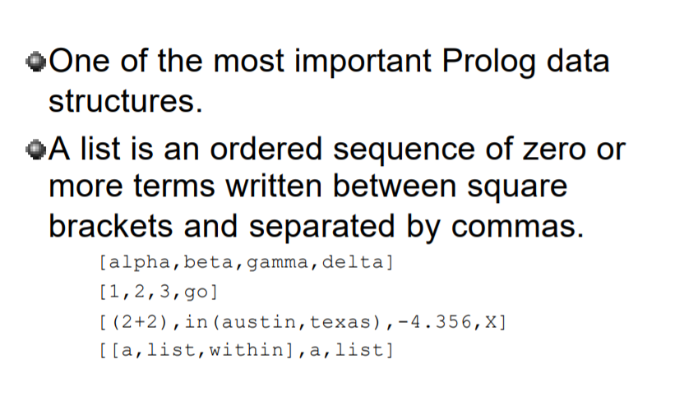
Prolog has a list construct denoted [...].
Elements are separated by commas.
[0, 2, 4, 9] is a list.

Slide 3
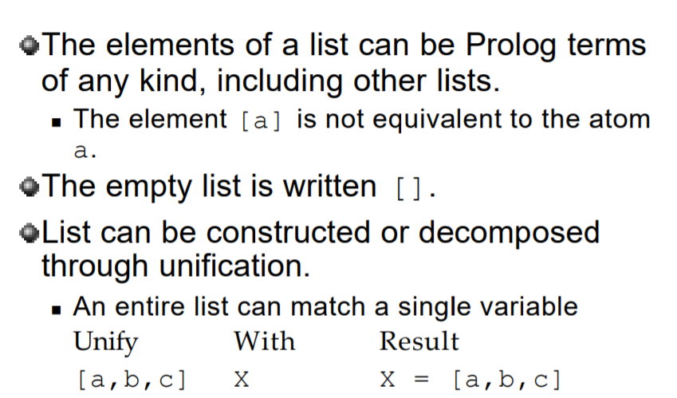

Slide 4
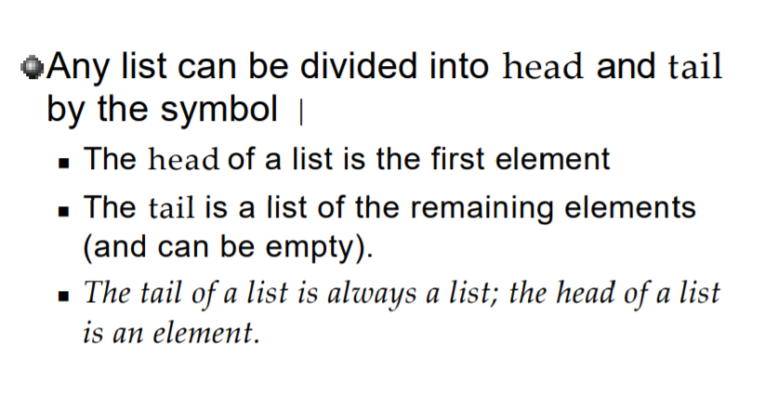

Slide 5
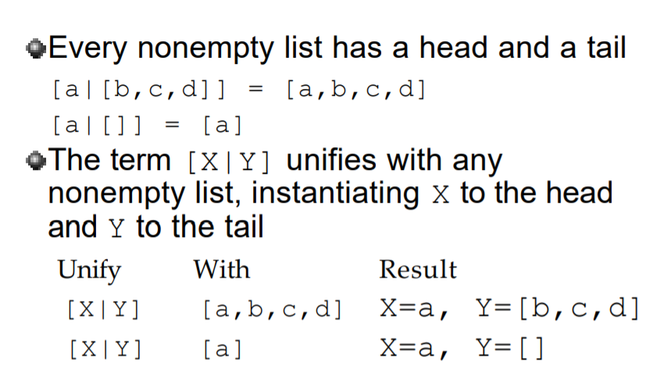

Slide 6
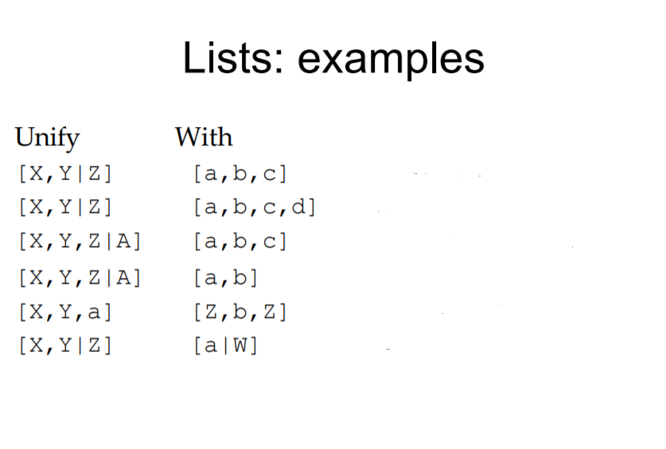

Slide 7
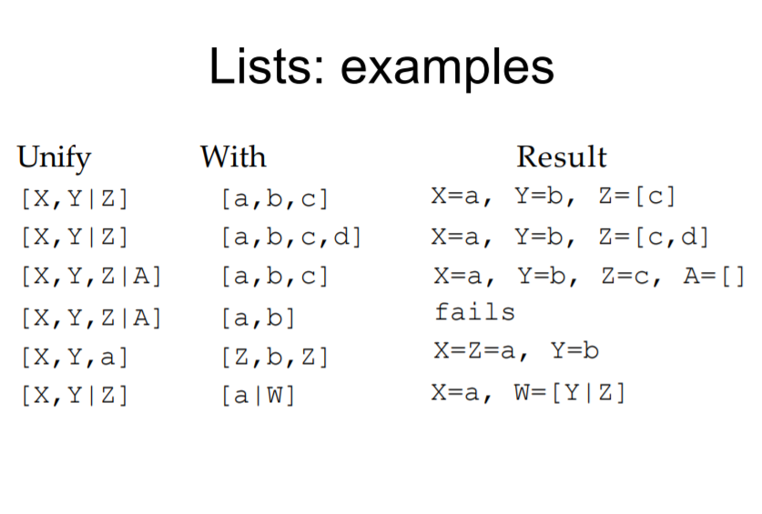

Slide 8
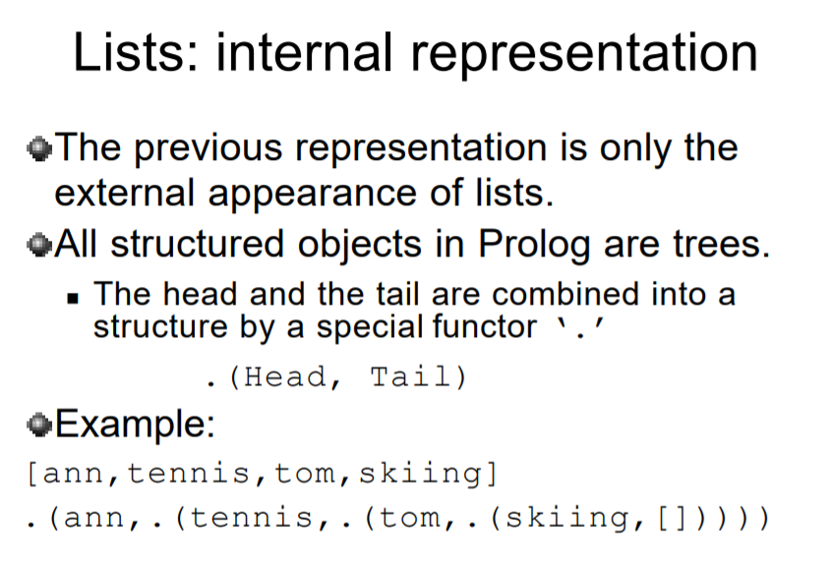

Slide 9
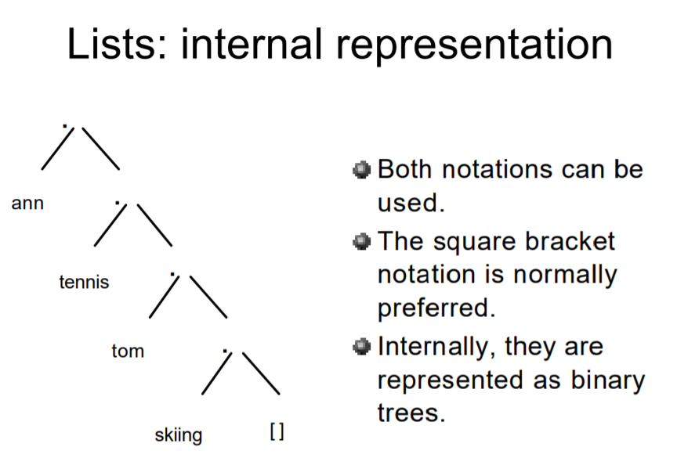

Slide 10
Recursion

Slide 11
The recursion in any language is a function that can call itself until the goal has been succeed.
In Prolog, recursion appears when a predicate contain a goal that refers to itself.

Slide 12
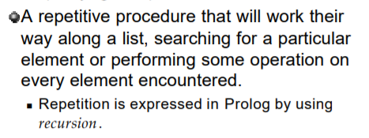
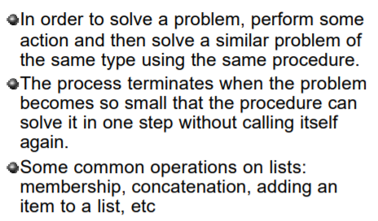

Slide 13
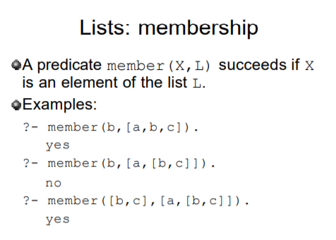

Slide 14
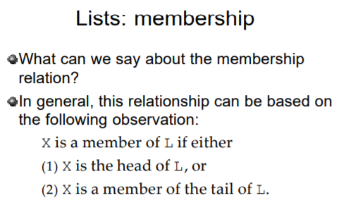

Slide 15
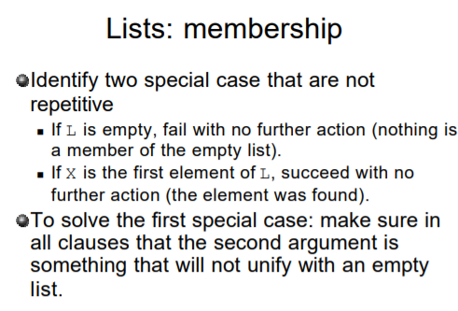

Slide 16
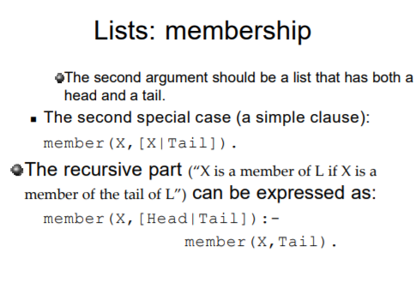

Slide 17
Suppose we posed the following query:
?- member(yolanda,[yolanda,trudy,vincent,jules]).
Prolog will immediately answer `Yes'. Why? Because it can unify yolanda with both occurrences of X in the first clause (the fact) in the definition of member/2, so it succeeds immediately.
Now consider the following query:
?- member(vincent,[yolanda,trudy,vincent,jules]).
Now the first rule won't help (vincent and yolanda are distinct atoms) so Prolog goes to the second clause, the recursive rule. This gives Prolog a new goal: it now has to see if
member(vincent,[trudy,vincent,jules]).
Now, once again the first clause won't help, so Prolog goes (again) to the recursive rule. This gives it a new goal, namely
member(vincent,[vincent,jules]).
This time, the first clause does help, and the query succeeds.
So far so good, but we need to ask an important question. What happens when we pose a query that fails? For example, what happens if we pose the query
member(zed,[yolanda,trudy,vincent,jules]).
Now, this should obviously fail (after all, zed is not on the list). So how does Prolog handle this? In particular, how can we be sure that Prolog really will stop, and say no, instead going into an endless recursive loop?
Let's think this through systematically. Once again, the first clause cannot help, so Prolog uses the recursive rule, which gives it a new goal
member(zed,[trudy,vincent,jules]).
Again, the first clause doesn't help, so Prolog reuses the recursive rule and tries to show that
member(zed,[vincent,jules]).
Similarly, the first rule doesn't help, so Prolog reuses the second rule yet again and tries the goal
member(zed,[jules]).
Again the first clause doesn't help, so Prolog uses the second rule, which gives it the goal
member(zed,[])

Slide 18
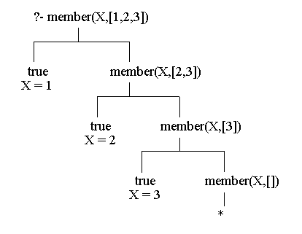

Slide 19
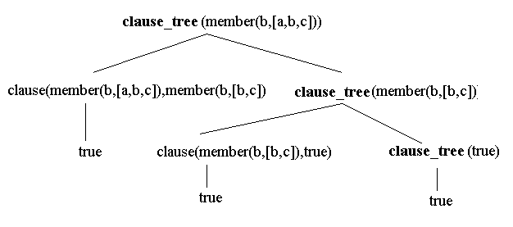

Slide 20
?- member(X,[23,45,67,12,222,19,9,6]), Y is X*X, Y < 100.
X=12
X=9
X=10

Slide 21
domains list=symbol* predicates add(symbol,list,list)
clauses add(X,[],[X]). add(X,[Y|Tail],[Y|Tail1]):- add(X,Tail,Tail1).
OUT PUT ======= Goal:
add(e,[a,b,c,d],NewList) NewList=["a","b","c","d","e"] 1 Solution

Slide 22
domains list=symbol*
predicates
add(symbol,list,list) clauses add(X,L2,[X|L2]).
OUT PUT =======
Goal: add(a,[b,c,d,e],NewList) NewList=["a","b","c","d","e"]
Solution

